Slide 1
Data Visualization Using Tableau
Submitted By : Honey Sharma

Slide 2
DATASET SHORT SUMMARY
I have used FIFA Players dataset for analysis.
FIFA stands for International Federation of Association Football.
This dataset contains all the information about various football players all around the world.
Dataset contains attributes like Name , Age, Nationality , Club, Market Value, Wage, Preferred Foot, International Reputation ,Position ,Jersey Number , Joined Date , Height ,Weight, Release Clause Value etc.
Dataset Source = https://www.kaggle.com/karangadiya/fifa19

Slide 3
PROBLEM STATEMENTS :
Which Country has highest number of football players?
Comparison of different Players on the basis of there Market Value and Wage.
How many new players join football community every year?
Which Player has the highest Release Clause Value?
Which Football club has highest Market Value?
How many Players are lefty or Righty?

Slide 4
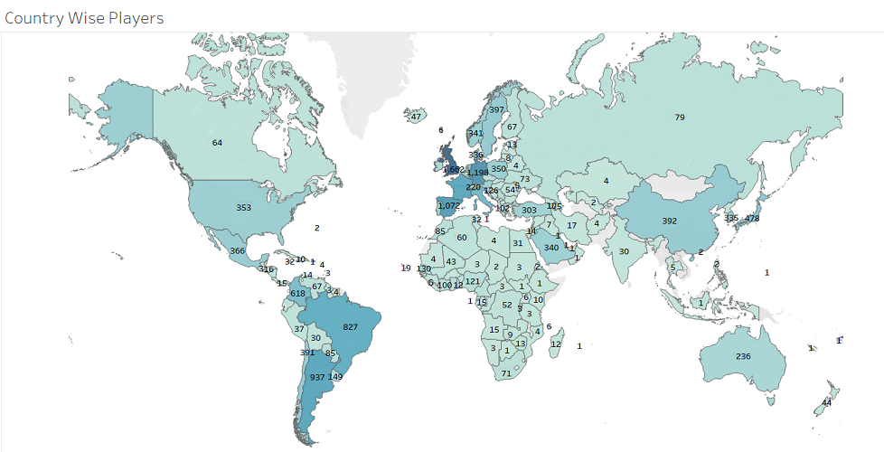
Problem Statement: Which Country has highest number of football players?
Conclusion
England has the highest Number of football players followed by Germany and Spain.

Slide 5
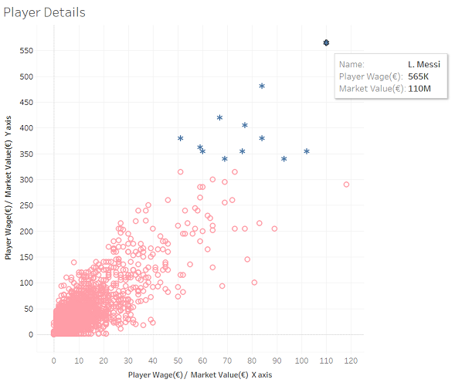
Problem Statement: Comparison of different players on the basis of there market value and wage.
Conclusion
Lionel Andrés Messi has the highest Wage i.e. 565K € .
Neymar Jr. has the highest Market Value i.e. 118M €.

Slide 6
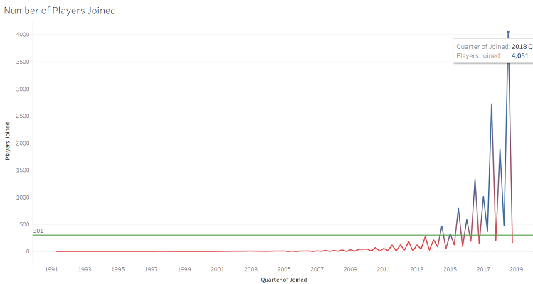
Problem Statement: How many new players join football community every year?
Conclusion
There is a sudden increase in joining of players after year 2015.
In 2018 maximum number of players joined football i.e. 4051.

Slide 7
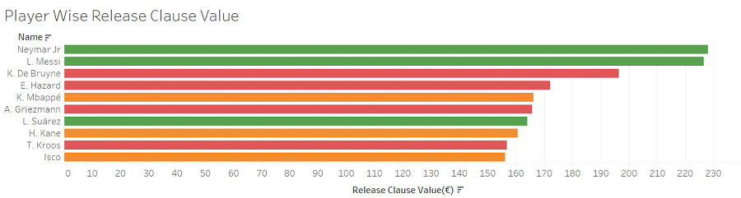
Problem Statement: Which Player has the highest Release Clause Value?
Conclusion
Neymar Jr. has the highest Release Clause Value i.e. 228M €.

Slide 8
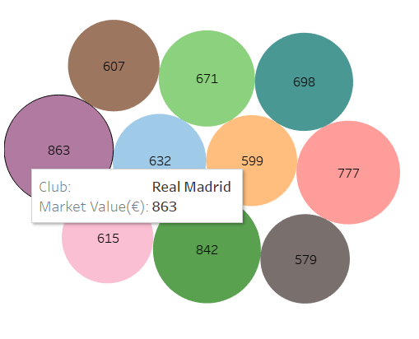
Problem Statement: Which Football club has highest Market Value?
Conclusion
Real Madrid club has the highest Market Value of 863M €.

Slide 9
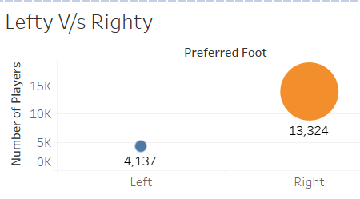
Problem Statement: How many Players are lefty or Righty?
Conclusion
There are more righty players than lefty.

Slide 10
SUMMARY
European Countries have more trend of Football compare to all other countries.
Players like Messi , Neyman Jr., Ronaldo are among top players.
Football became popular in year 2015.
Clubs like Real Madrid , FC Barcelona , Manchestar City are very popular in football community.

Slide 11
VIDEO EXPLANATION LINK
https://drive.google.com/drive/folders/1UI2CUugynWnVhpsxi82COAuIeFTXoQ9h?usp=sharing

Slide 12
THE END
Thankyou

